Slide 1
INDIAN agriculture Analysis
Project 2
Using Power BI
@MENTORNESS
Batch: MIP-DA-04
By Dharmindar Ram

Slide 2
INDIAN Agriculture Analysis
Agenda
Overview
Approach Used
Key Areas
Dashboarding
Insights
By Dharmindar Ram @MENTORNESS

Slide 3
Overview
INDIAN Agriculture Analysis
Key Skills Practised
Power BI
Data Visualization
Business Insights
By Dharmindar Ram @MENTORNESS

Slide 4
INDIAN Agriculture Analysis
Overview
Project Purpose
project aims to conduct a comprehensive analysis of Indian agriculture, focusing on district-wise and year-wise data. The goal is to leverage Power BI to create interactive visualizations that uncover trends and pattern.
By Dharmindar Ram @MENTORNESS

Slide 5
INDIAN Agriculture Analysis
Overview
About Project
You are given a dataset containing data of INDIAN Agriculture and asked to perform comprehensive data analysis using Power BI and provide deliverables.
By Dharmindar Ram @MENTORNESS

Slide 6
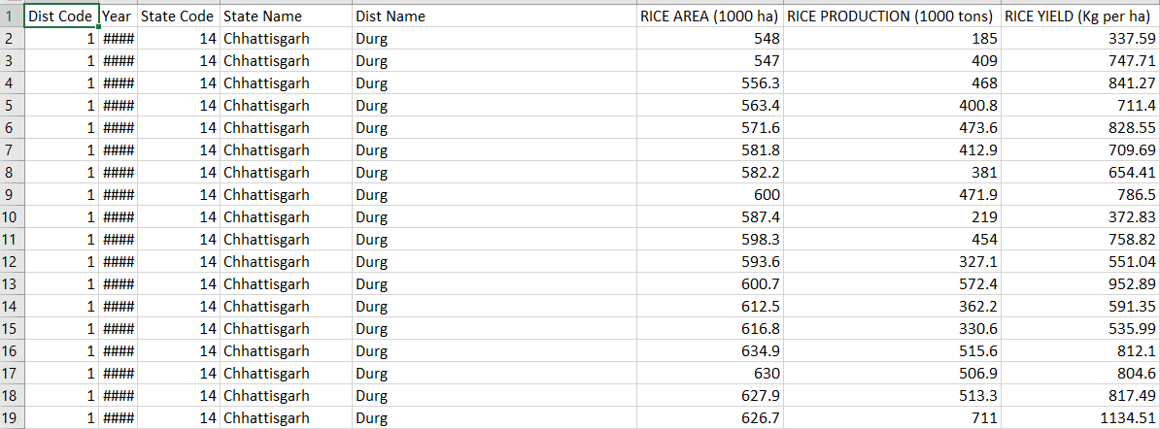
INDIAN Agriculture Analysis
Overview
About Data
Raw dataset contains 80 columns and 16147 records.
By Dharmindar Ram @MENTORNESS

Slide 7
INDIAN Agriculture Analysis
Approach Used
Approach Steps:
Imported data from csv file into Power BI
Transformed it.
Analysed it using visualizations and DAX(Data Analysis Expression)
Created reports and designed dashboards
By Dharmindar Ram @MENTORNESS

Slide 8
INDIAN Agriculture Analysis
Key areas
Year wise breakdown
Crop Specific Analysis
Seasonal trends
State wise breakdown
District wise breakdown
Fruits and Vegetables analysis
By Dharmindar Ram @MENTORNESS

Slide 9
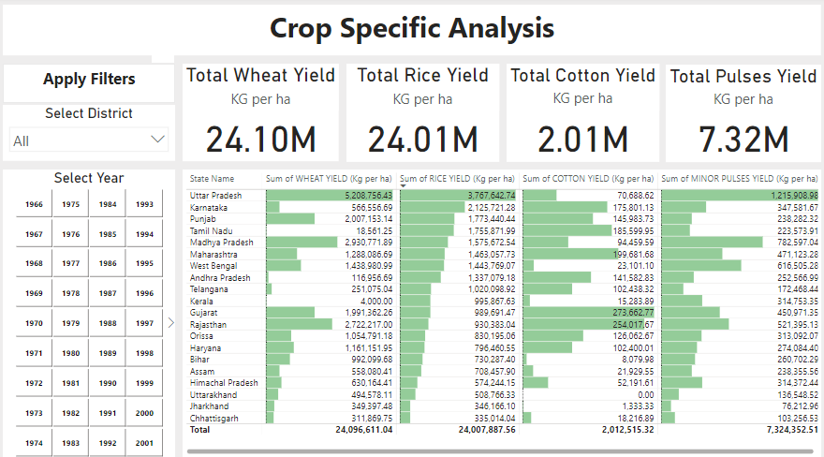
INDIAN Agriculture Analysis
Dashboarding
Designed dashboard for crop specific analysis
By Dharmindar Ram @MENTORNESS

Slide 10
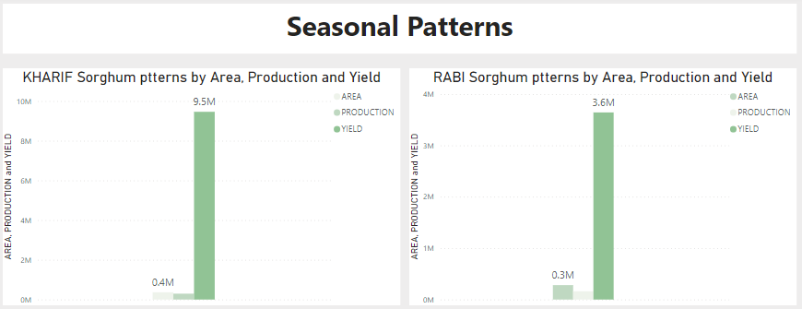
INDIAN Agriculture Analysis
Dashboarding
Uncovered seasonal trends using Clustered Column Charts
By Dharmindar Ram @MENTORNESS

Slide 11
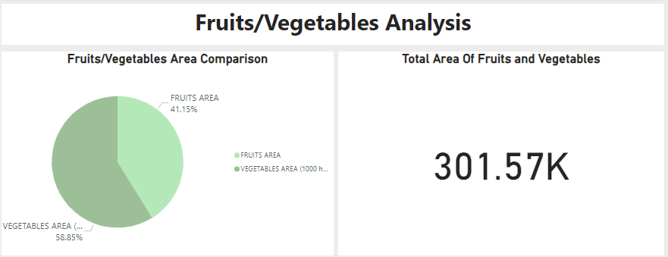
INDIAN Agriculture Analysis
Dashboarding
Explored patterns for cultivation areas of fruits and vegetables
By Dharmindar Ram @MENTORNESS

Slide 12
INDIAN Agriculture Analysis
insights
Uttar Pradesh gave maximum yields of WHEAT, RICE and PULSES
Gujrat and Rajasthan are main COTTON yield producers
KHARIF sorghum gave more yield than RABI sorghum
Vegetables and Fruits cultivation areas have ratio of 58.85% and 41.15% respectively.
By Dharmindar Ram @MENTORNESS

Slide 13
INDIAN Agriculture Analysis
Recommendations
Improve cultivation practices in states where crops yields are low to get good results.
Provide fertilizers, pesticides and seeds of good quality to improve yields.
Equip Farmers with latest agriculture technology, also train them to have improved results.
Stay alert with weather conditions to take right steps before any harmful cause.
By Dharmindar Ram @MENTORNESS

Slide 14
Thank You

